Slide 2
Enterprise

Slide 4
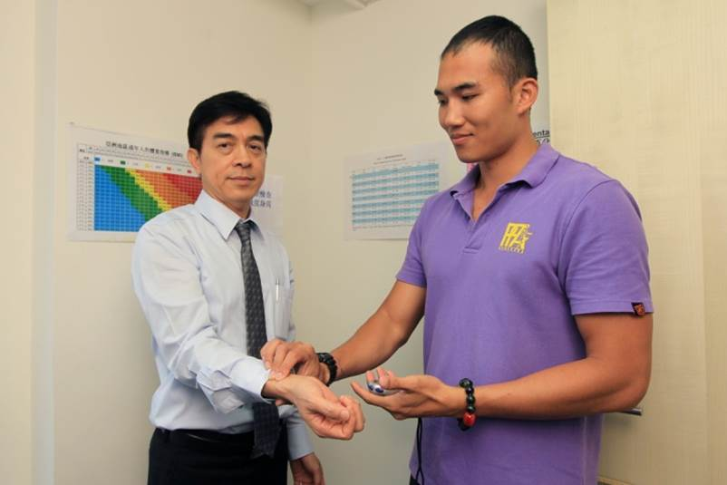
Our Journey to be a Healthier Company
Health Day

Slide 5
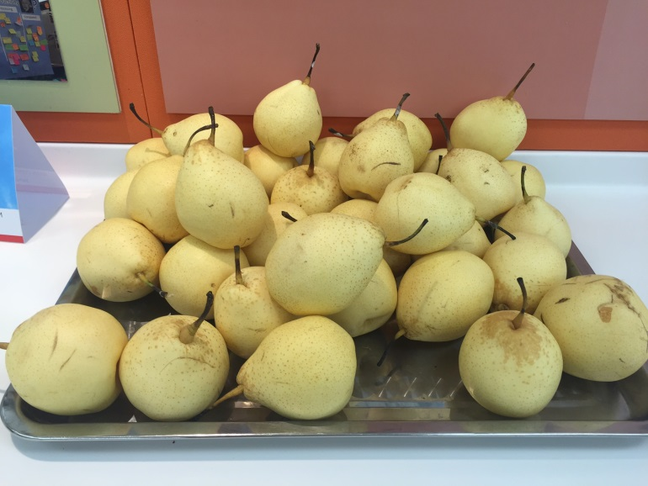
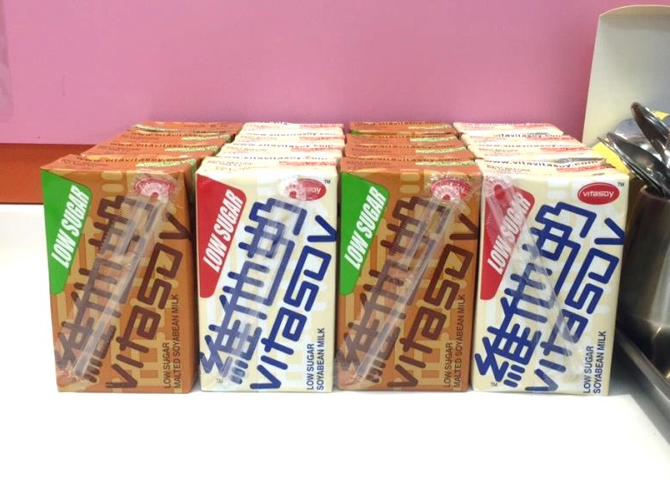
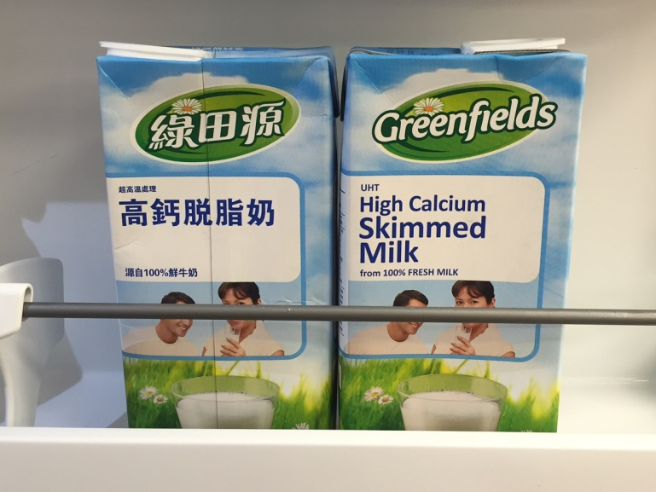
Healthy Diet - Lifestyle Changing
Fruity Monday
Adopt Healthy Formula
Low-sugar Drinks
Skimmed Milk

Slide 6
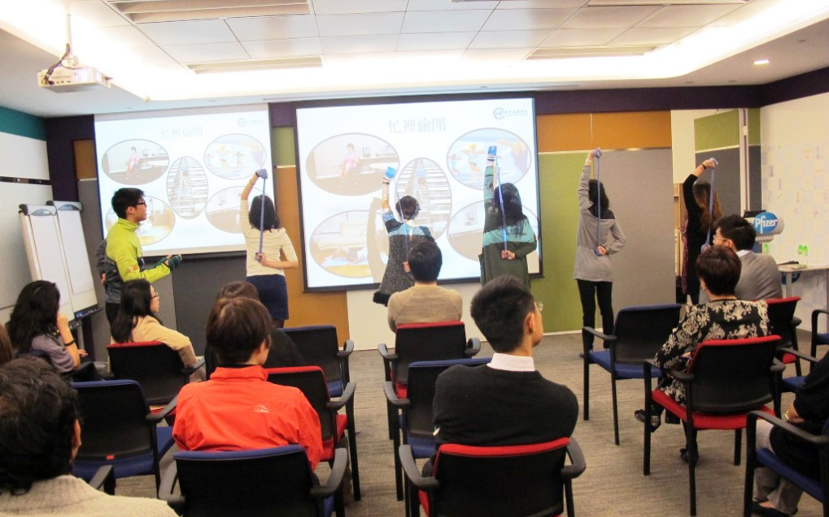
Being ‘Active’ in Office - More Exercises
Sketching 伸展運動
Brain Gym 腦有運動
Acupressure 「穴」按愈鬆
Health Talks

Slide 7
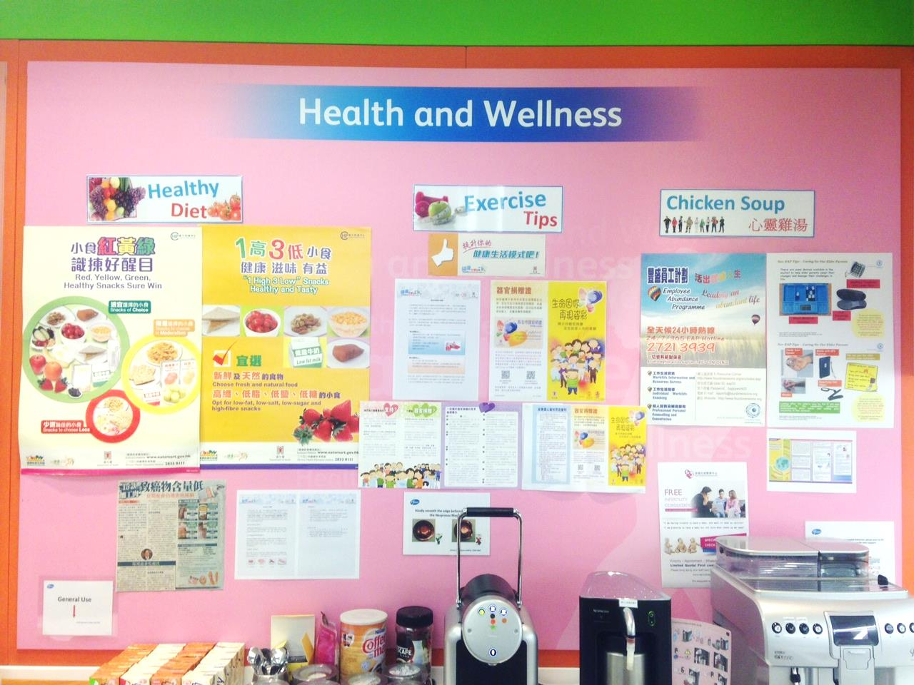
Health Knowledge Bank

Slide 8
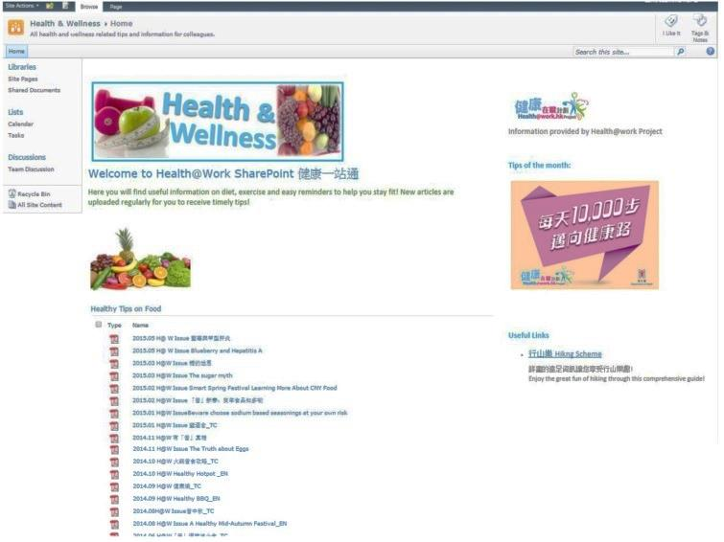
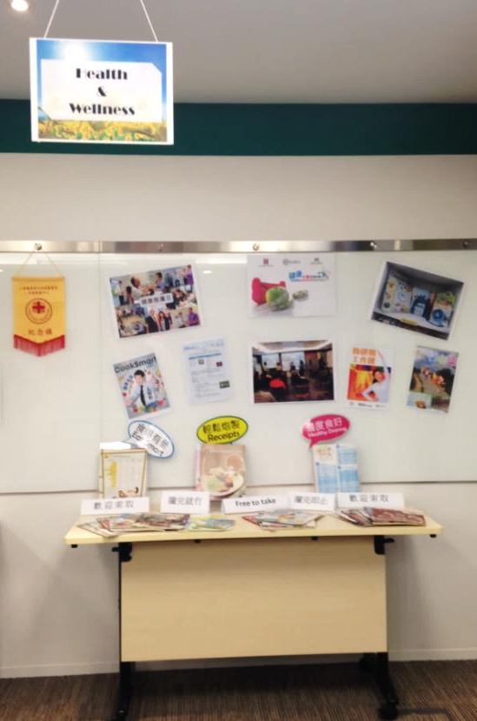
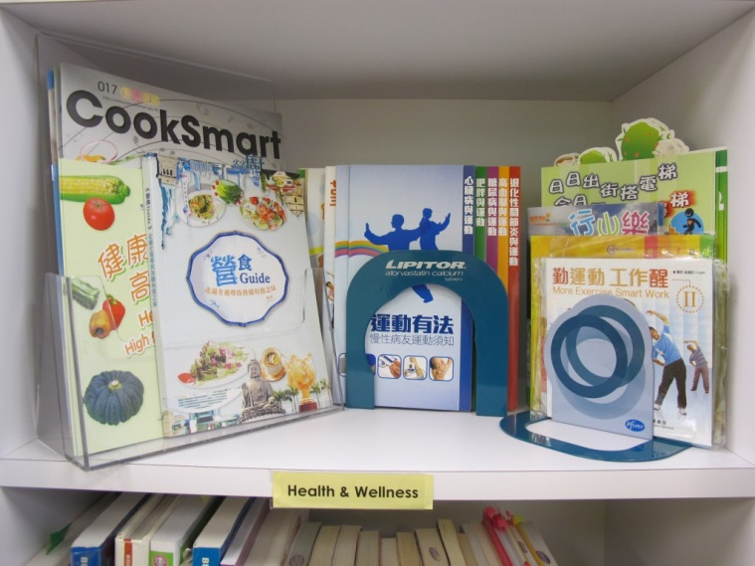
Health Reminder Platform
Health@work Sharepoint @Intranet
Library Health Section
Health Promotion & Wellness Corner

Slide 9
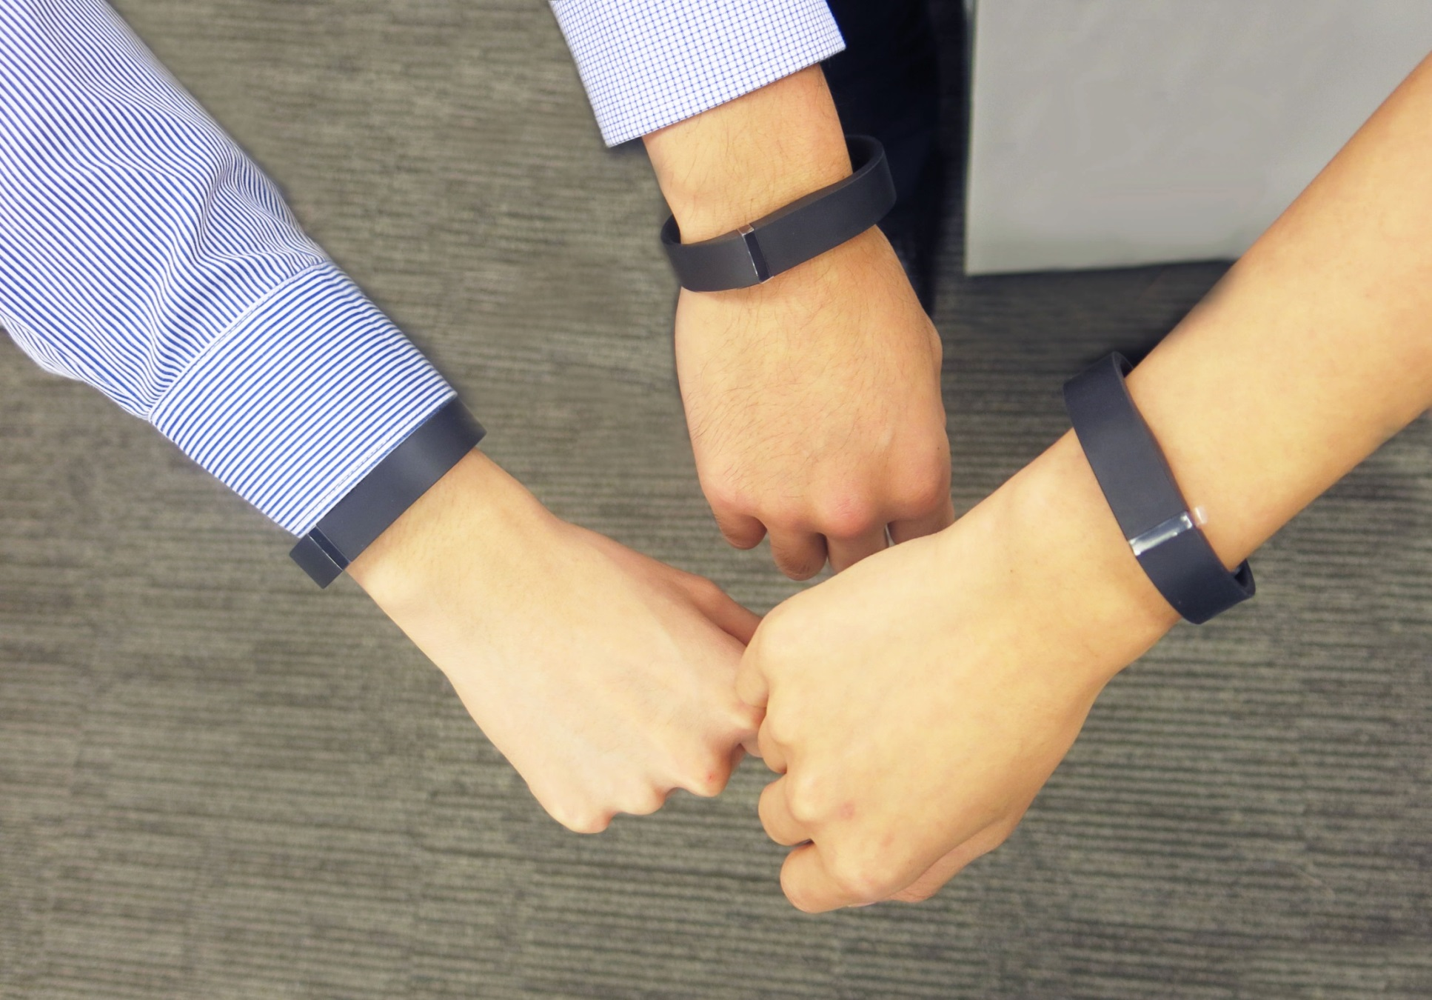
Inspire for More, Invest for Health

Slide 10
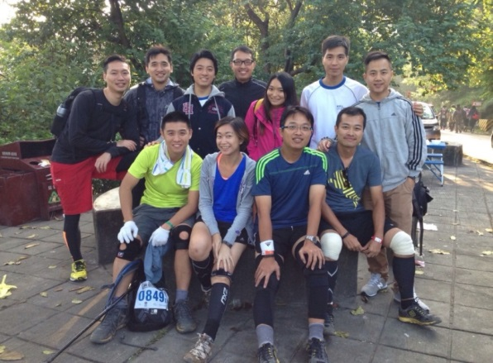
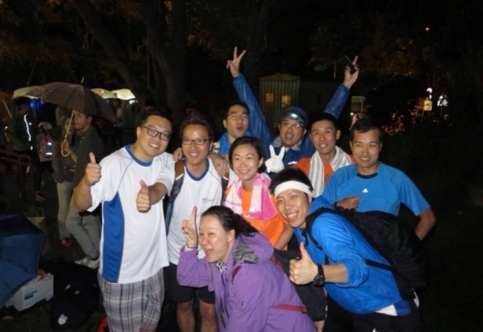
Go Beyond & Mindset Change

Slide 11
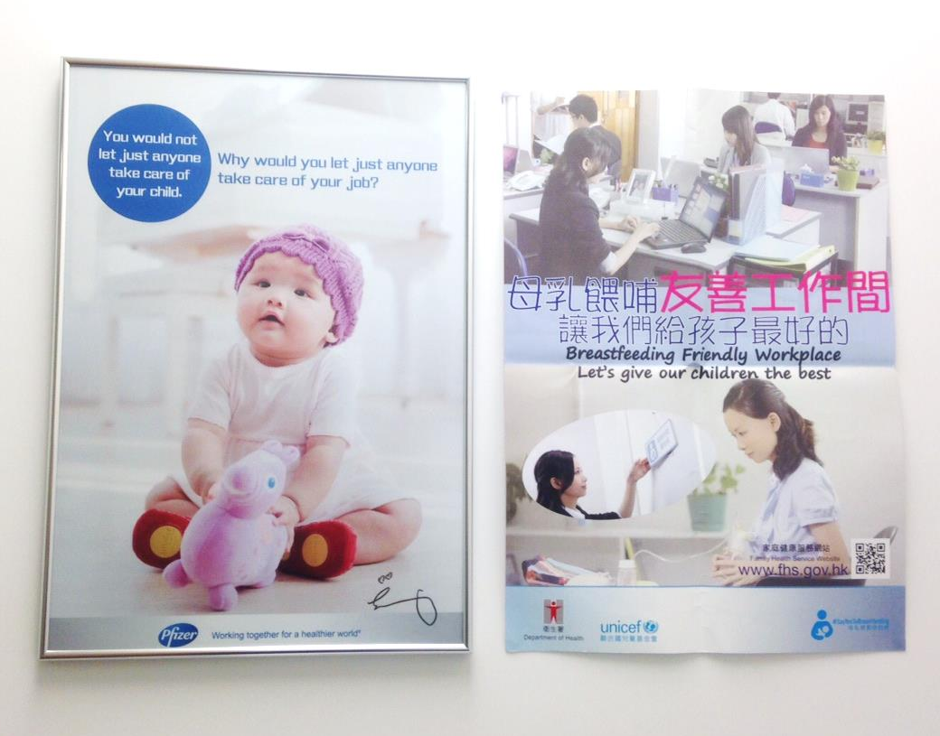
Caring for Working Mom - Breastfeeding Room

Slide 12
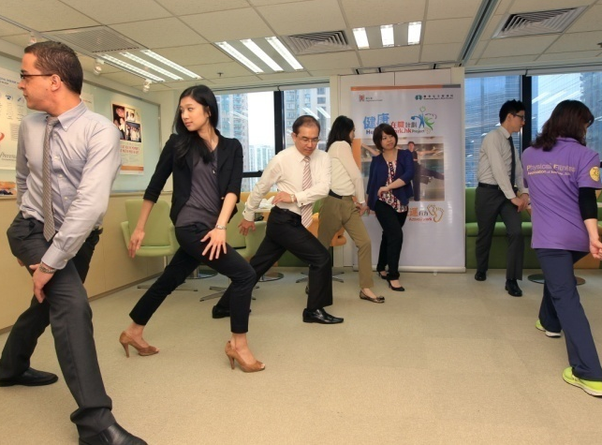
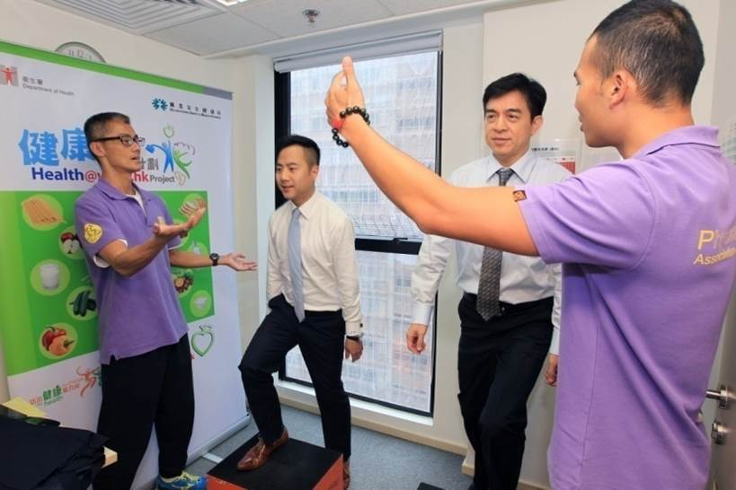
Become more Health Conscious

Slide 13
健康在職 理想成果
病假
醫療保險
歸屬感
離職率
全體BMI

Slide 14
ANGEL

